Slide 1
Course code: ICT 3103 Course Title: Analog and Digital Communication Semester: V (March-June 2022) Course Teacher Dr. Monir Morshed Professor, Dept. of ICT Email:monirmorshed.ict@mbstu.ac.bd

Slide 2
Course Contents
Radio Wave Propagation: Surface and space wave propagation, Sky wave through Ionosphere. Pulse method for measuring height and electron concentration of Ionospheric region; Chapman theory of layer formation, Ionospheric storm.
Modulation and Demodulation: Linear modulation - AM, SSB, DSB, and SSB generation, PLL Circuit to generate linear modulated signals, low and high power modulators, Exponential modulation- FM and PM, demodulation of AM, FM.
Broadcasting Transmitter: Transmitter classification, Elements of transmitter, AM and FM transmitters, SSB transmitter, stabilized master oscillator, Frequency multipliers, Mixer circuits, RF power amplifier, Pre-emphasis circuits, Transmitter performance-carrier frequency requirements, audio frequency response, distortion, and signal to distortion ratio.
Radio Receiver: Receiver classification, Elements of receiver, AM and FM receivers, SSB receiver, Comparison of AM and FM receivers, Noise in receiver, AGC circuits, AFC circuits, Noise limiters, Receiver sensitivity, Cross modulation, Spurious responses.
Representation of Random Signals and Noise in Communication System: Signal Power and Spectral Representations, White noise, Thermal noise, PSDF of White Signals. Input and Output Relationship for Random Signals and Noise Passed Through a Linear Time Invariant System, Band Limited White Noise, ARC Filtering of White Noise.

Slide 3
Course Contents
Elements of Digital Communication Systems: Elements of Digital Communication Systems: Model of Digital Communication Systems, Digital Representation of Analog Signal, Certain issues in Digital Transmission, Advantages of Digital Communication Systems, Bandwidth-S/N tradeoff, Hartley Shannon Law.
Pulse Code Modulation: Pulse Code Modulation: PCM Generation and Reconstruction, Quantization noise, Non uniform Quantization and Companding, DPCM, Adaptive DPCM, DM and Adaptive DM. Noise in PCM and DM.
Digital Modulation Techniques: Digital Modulation Techniques: Introduction, ASK, ASK Modulator, Coherent ASK Detector, Non-Coherent ASK Detector, FSK, Bandwidth and Frequency Spectrum of FSK. Non coherent FSK Detector, Coherent FSK Detector, FSK Detection Using PLL, BPSK, Coherent PSK Detection, QPSK, Differential PSK.
Line Coding: Techniques and Analysis.
Required Text Books:
B.P.Lathi, "Modern Digital & Analog Communication", Prison Books Pvt Ltd., 1989
Sanjay Sharma, "Communication Systems, Analog & Digital
Reference Books:
Simon Haykin, "Communication System", John Wiley & Sons, 4th Edition, 1991
K.Sam Shanmugam, "Digital & Analog Communication System", John Wiley & Sons

Slide 4
Course Objectives
To introduce with basic communication systems.
Various Amplitude modulation and demodulation systems
Various Angle modulation and demodulation systems
Basics of Noise theory and performance of various receivers.
Design modulation and optimum demodulation and detection methods for digital communications over an AWGN channel.
Calculate the error rate performance for a number of modulation schemes in AWGN environments

Slide 5
Course Outcomes
Understand basic elements of a communication system
Conduct analysis of baseband signals in time domain and in frequency domain
Demonstrate understanding of various analog and digital modulation and demodulation techniques.
Analyze the performance of modulation and demodulation techniques in various transmission environments
Understand the importance of noise considerations in communication systems.
Baseband and band-pass transmission techniques
Detection & Estimation of signal

Slide 6
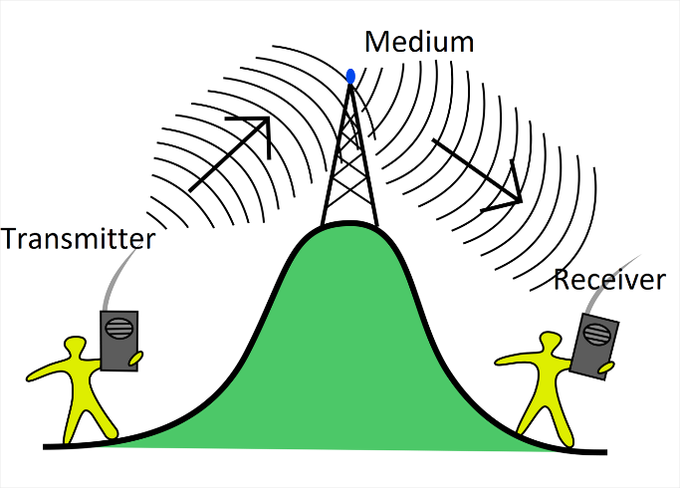
Communication Engineering concerned with the sending and receiving of signals especially by means of electrical devices and electromagnetic waves.

Slide 7
Introduction
“Communication is the process of establishing connection or link between two points for information exchange”
The examples of communication:
Ancient communication
Telegraph
Line telephony
Radio telephony
Radio telegraph
Point to point communication
Mobile communication
Computer communication
Radar communication
Television broadcasting
Radio telemetry
Radio aids to navigation
Radio aids to aircraft landing

Slide 8
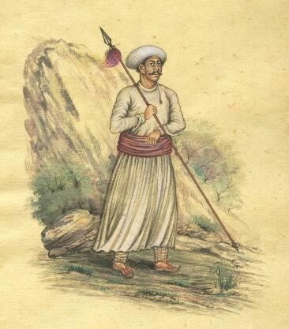


Ancient Communications
Harkara
Pigeons
Fire and Smoke

Slide 9
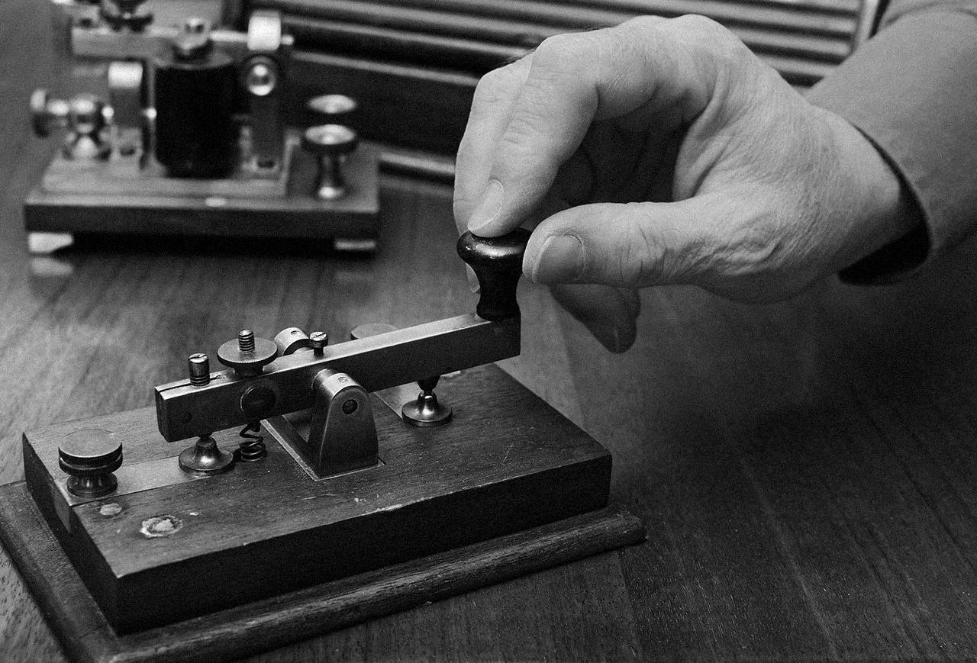
Telegraph (1836)
Invention Of Telegraph: First Wireless Communication

Slide 10
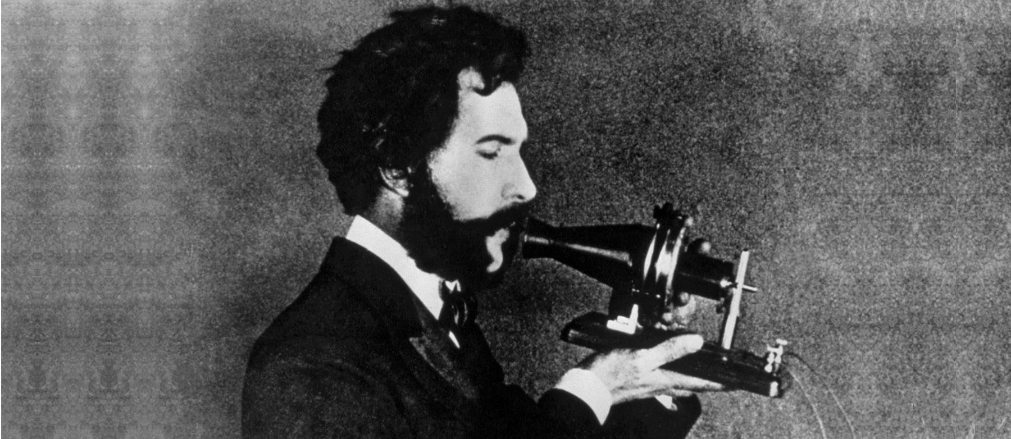
Telephone (1876)
Invention Of Telephone By Alexander Graham Bell: The Beginning of Electricity Based Analog Communication

Slide 11
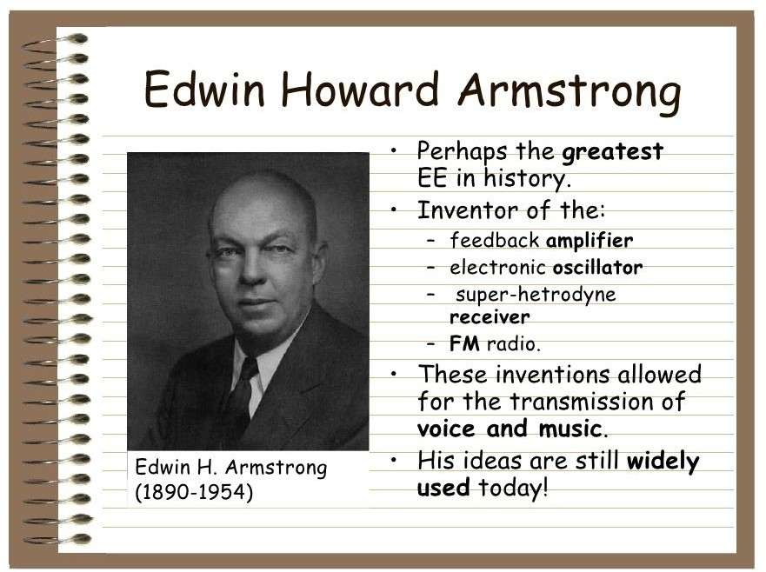
FM Radio(1933)

Slide 12
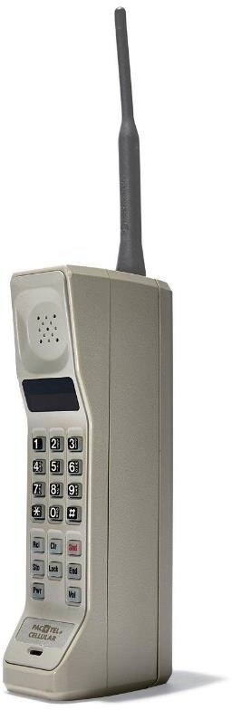
Mobile Phones (1983)
Mobile phone was first available commercially in 1983. This indicated the beginning of the large commercialization of communication systems.

Slide 13
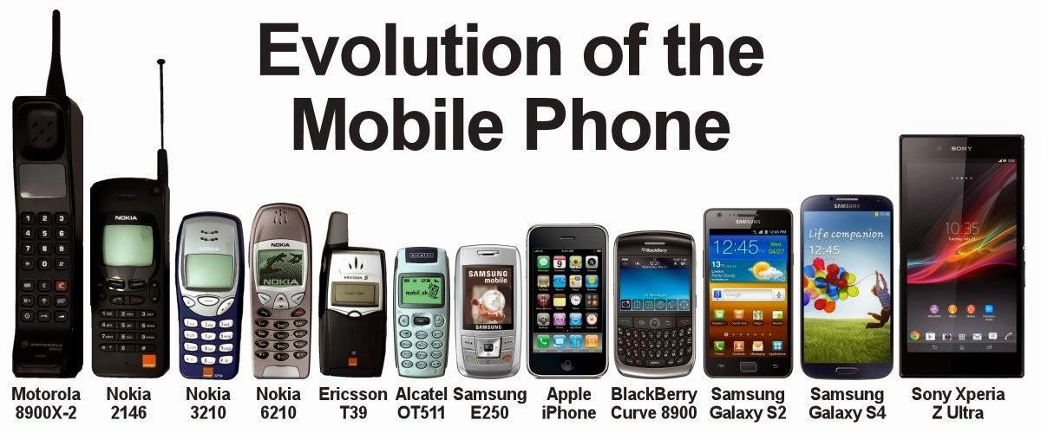
Contribution of Electronics in Communication Devices

Slide 14
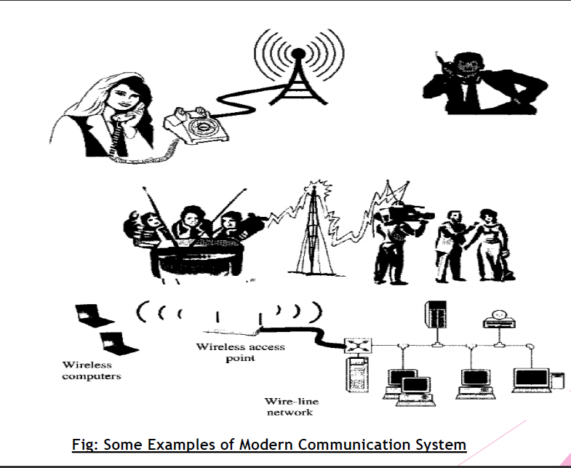

Slide 15
Modern Communication System
Message: sounds (voice, music), pictures, words, codes, light, temperature, pressure, etc.
Modulated signal in RF range (transmitted through channel)
Modulated signal in RF range (received from the channel)
Information in electrical signal/ modulating signal
Reconstructed electrical signal/ modulating signal
Information source
Input transducer
Transmitter (Modulator)
Channel
Receiver
Output transducer
Microphone, camera, scanner, etc.
Modulator (Analog: AM,FM.PM. Digital: ASK, FSK, PSK, DM)
Noise
Information in the original form
Figure: Block diagram of a communication system
Information source:
The message produced by the information source is not an electrical in nature.
Such as voice, music pictures, words, codes, lights, temperature etc.
So we need transducer to convert from physical message to electrical signal.
Input transducer:
It converts one form of energy into another form.
It is used to convert physical message signal into time varying electrical signal.
Transmitter:
Here, restriction of range of audio frequencies, amplification, and modulation are achieved.
Modulation is the superimposed of audio signal upon the high-frequency carrier signal.

Slide 16
Modern Communication System
The channel and the Noise:
It is the path through which the signal propagates from transmitter to receiver.
It may be a pair of wires, a coaxial cable, microwave links or radio waves or space.
In the channel, the signal gets distorted due to noise introduced in the system.
Noise signals are always random in character.
Receiver:
It receives information from the modulated signal available at the transmission channel.
The main function of the receiver is to extract the original message signal from the degraded version of the transmitted signal.
Example: TV sets and Radio set are example for receivers
Destination:
Destination is the final stage where electrical message signal is converted into its original form, such as voice, message, etc.
For example, in radio broadcasting, loudspeaker which works as a transducer.

Slide 17
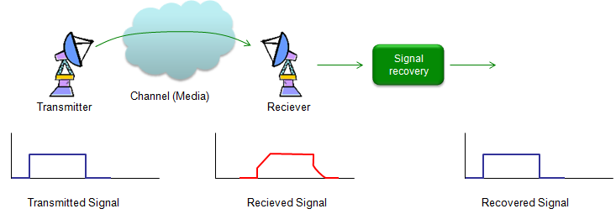
Modern Communication System

Slide 18
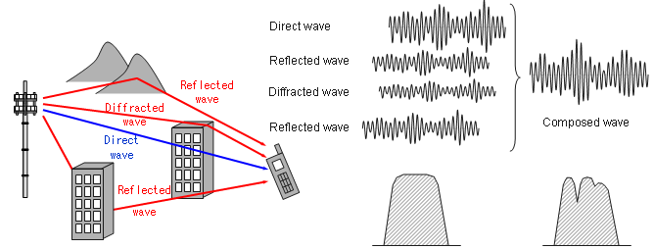
Modern Communication System

Slide 19
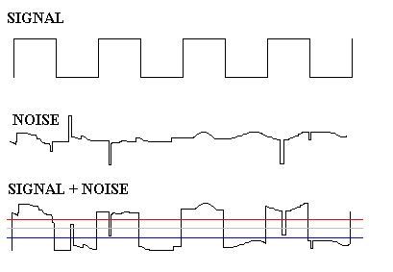
Noise
Noise in a communication system is basically undesirable or unwanted signals that get randomly added to the actual information carrying signal

Slide 20
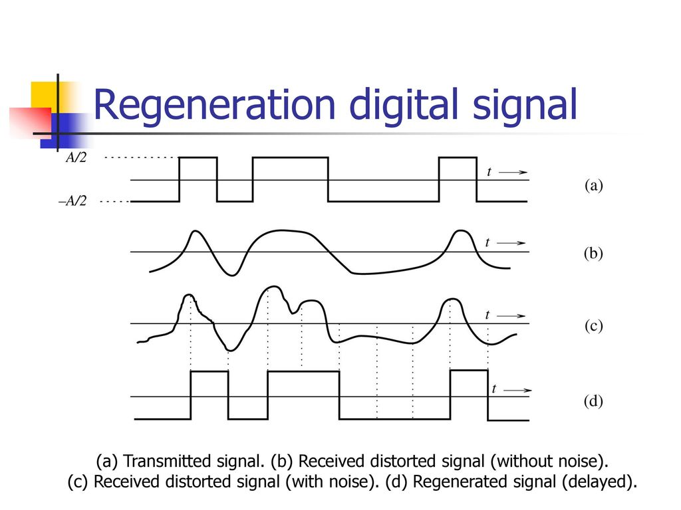

Slide 21
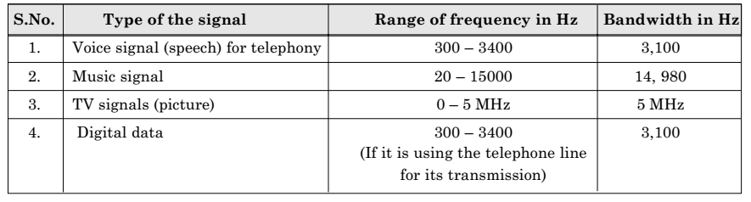
Bandwidth
The bandwidth is the frequency range over which an information signal is transmitted
We may also say that bandwidth is the difference between the upper and lower frequency limits of the signal.
Bandwidth
BW
0
f₁ =20 Hz
f₂ =15kHz
Frequency, f
For example, the range of music signal is 20 Hz to 15 kHz, therefore, as shown in the above figure, the bandwidth is
BW= f₂-f₁
BW=15000-20=14980 Hz.

Slide 22
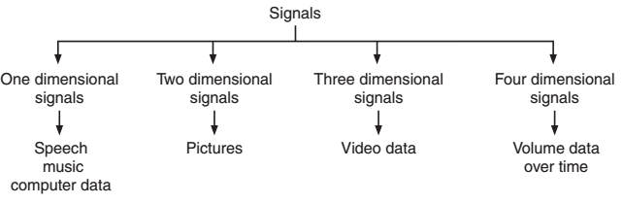
Signal
A signal may be defined as the single valued function of time.
Speech: The band of frequencies required for the speech communication is 300 Hz to 3100 Hz. This band is utilized for the commercial telephonic communication.
Music: Music signal is a bipolar signal and it requires a bandwidth of about 15 kHz.
Video: The bandwidth required for this video signal is 0 to 5 MHz.
Computer Data: The text transmitted by a computer is encoded using American Standard Code for Information Interchange (ASCII)

Slide 23
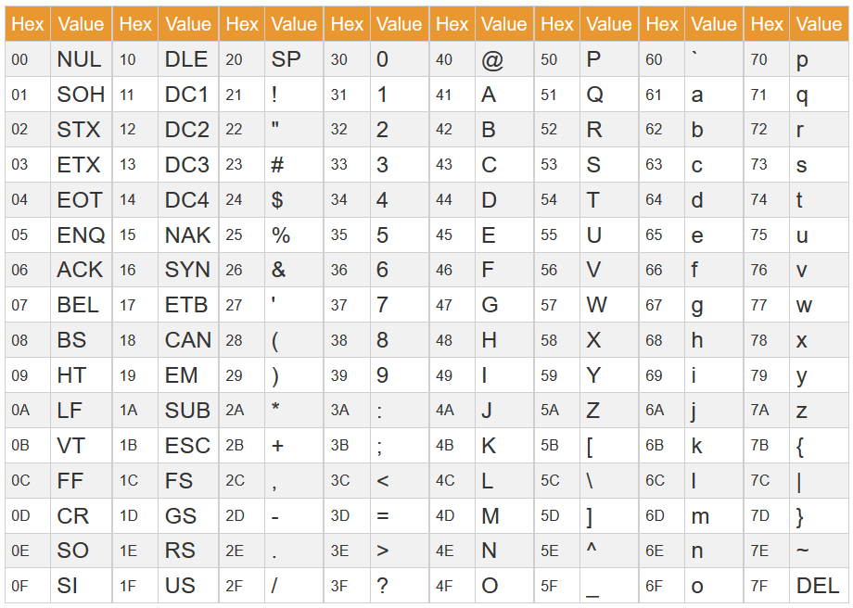
ASCII code set

Slide 24
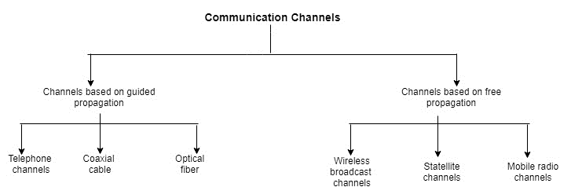
Communication Channels
Some important characteristics of a channel are:
Power required to achieve the desired S/N ratio.
Bandwidth of the channel.
Amplitude and phase response of channel.
Type of channel (linear or non-linear).
Effects of external interference on the channels.

Slide 25
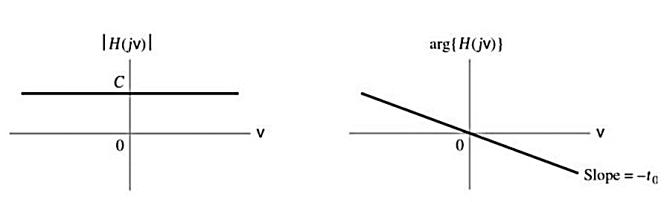
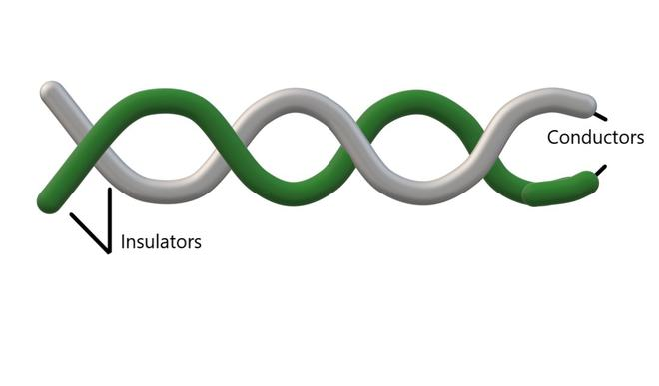
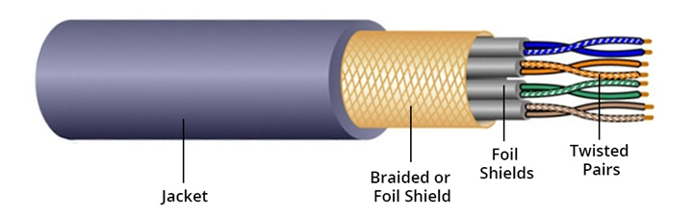
Communication Channels
Telephone channels:
It is designed for providing service to voice signals such as telephones
Bandpass characteristics over 300 to 3400 Hz.
High signal to noise ratio of about 30 dB.
Approximately linear response.
Example of telephone channels: A common examples is twisted pair cable.
Advantages: It is quite cheaper.

Slide 26
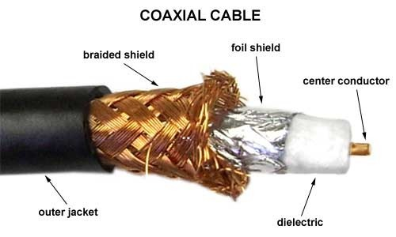
Communication Channels
Co-axial cables:
It was initially developed as the backbone of analog telephone networks
A single cable would be used to carry more than 10,000 voice channels.
Two types of cables having 75 Ω and 50 Ω impedance are available.
Because of shielding, this cable has noise immunity.
It has large bandwidth and low losses
This cable is suitable for both point to point or point to multipoint applications.
It expensive than twisted pair cable however, cheaper than optical fiber.
Repeaters are used after every 1 km to achieve data rates 8.5 Mb/s to 274 Mb/s
Advantages: co-axial cables provide higher immunity to electromagnetic interference and higher bandwidth compared with twisted pair cables.

Slide 27
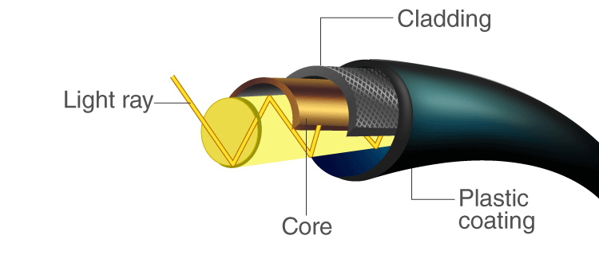
Communication Channels
Optical fiber cables:
An optical fiber is a very thin strand of plastic or glass that is used to transmit messages via light.
It consist of an inner glass core. High bandwidth
Long distance
Immunity to electromagnetic interference required
It can transmit voice, video, and telemetry through LAN, computer networks, or across long distances.
Advantages: Small size and light weight, easy availability and low cost, no electrical or electromagnetic interference, large bandwidth.
Disadvantages: High initial cost, Maintenance and repairing cost, Jointing and test procedures, Tensile stress, Fiber losses.

Slide 28
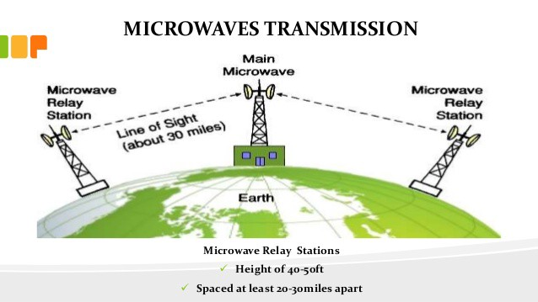
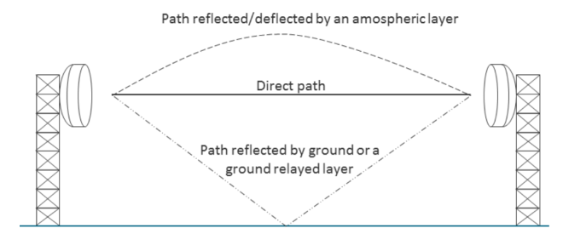
Communication Channels
Terrestrial microwave channel:
Terrestrial microwave channel requires a line of sight path between a sender and a receiver.
Unidirectional
Repeaters are needed for long distance communication.
No adverse effects such as cable breakage etc.
Very high frequency microwave cannot penetrate walls
Less maintenance compared with cables.
Microwave waves are used for cellular networks, satellite and wireless networks.
Advantages: No cables needed, multiple channel available, wide bandwidth.
Disadvantages: Signal strength at the receiving antenna reduces due to multipath reception.

Slide 29
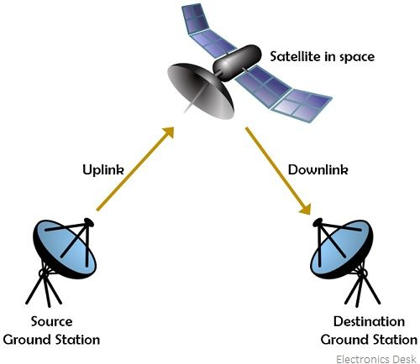
Communication Channels
Satellite channel:
A communication satellite is a microwave relay station.
Used to link two or more ground stations
It uses frequency range between 11 GHz and 14 GHz.
The message signal transmitted by the earth station to the satellite is called as an uplink frequency.
It is amplified and down converted in frequency by the transponder.
The signal from satellite to earth is called downlink frequency.
It receives signal on one frequency (uplink=6 GHz) and transmits on another frequency (downlink= 4 GHz).
Rotation match occurs at a height of 35,683 km at the equator.
Disadvantages: The cost of building and launching is very high.

Slide 30
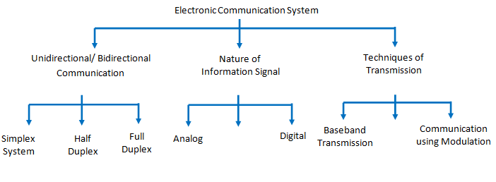
Electronic communication systems
Classification: The electronic communication may be classified into three groups based on
whether the system is unidirectional or bidirectional.
Whether it uses an analog or digital information signal/modulating signal.
Whether the system uses baseband transmission or use some kind of modulation.
Fig. Classification of electronic communication system

Slide 31
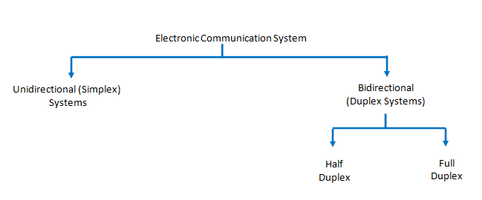
Based on direction of communication
Based on the direction of communication, the communication systems are:
Simplex systems
Half duplex systems
Full duplex systems
Simplex systems: The information is communicated in only one direction such as the radio and TV broadcasting.
Half duplex systems: The information is communicated in bi-direction but one at a time such as walky-talky.
Full duplex systems: The information is communicated in both direction simultaneously such as telephone.

Slide 32
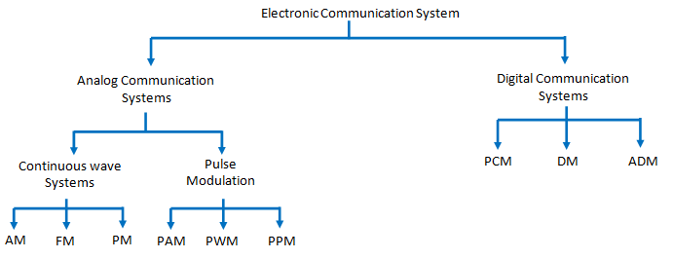
Based on nature of information signal
Based on the nature of information signal the communication systems are:
Analog communication: The modulation systems or techniques in which one of the characteristics (amplitude, phase or frequency) of the carrier is varied in proportion with the instantaneous value of modulating signal is called as analog modulation system.

Slide 33
Examples of analog modulation: Following are the examples of analog modulation systems :
Amplitude modulation (AM)
Frequency modulation (FM)
Phase modulation (PM)
Pulse Amplitude Modulation (PAM)
Pulse Width Modulation (PWM)
Pulse Position Modulation (PPM)
Advantages of analog communication:
Transmitters and receivers are simple
Low bandwidth requirement
FDM (Frequency division multiplexing) can be used
Drawbacks of analog communication:
Noise affects the signal quality
It is not possible to separate noise and signal
Repeaters can not be used between transmitter and receiver
Coding is not possible
It is not suitable for the transmission of secret information
Applications:
Radio broadcasting (AM and FM)
TV broadcasting
Telephones

Slide 34
Digital communication
The modulation system or technique in which the transmitted signal is in the form of digital pulses of constant amplitude, constant frequency and phase is called as digital modulation system : The common applications are: Long distance, communication between earth and space ships , Satellite communication, Military communication, Telephone systems, Data and computer communications
Examples of digital modulation: Following are the examples of analog modulation systems :
Pulse code modulation (PCM)
delta modulation (DM)
Advantages of analog communication:
Reliable communication, less sensitivity to changes in environmental conditions (such as temperature)
Easy multiplexing, easy signaling
Voice and data integration
Easy processing like encryption and compression
Integration of transmission and switching
FDM (Frequency division multiplexing) can be used
Drawbacks of Digital Communication:
The bit rates of digital systems are high . Therefore, they require a larger channel bandwidth as compared to analog system .
Digital modulation needs synchronization in case of synchronous modulation .

Slide 35
Classification based on technique of transmission
Based on the technique used for the signal transmission, we can categorize the electronic communication system as under :
Baseband transmission system
Communication systems using modulation
Baseband transmission systems: In baseband transmission systems, the baseband signals (original information signals/modulating signal) are directly transmitted such as telephone network
Limitations:
It cannot be used for free space communication because it gets suppressed after a short distance.
Note: we can overcome this limitations using modulation
Communication systems using modulation:
In the modulation process, two signals are used namely the modulating signal and the carrier .
The modulating signal is nothing but the baseband signal or information signal while the carrier is a high frequency sinusoidal signal .

Slide 36
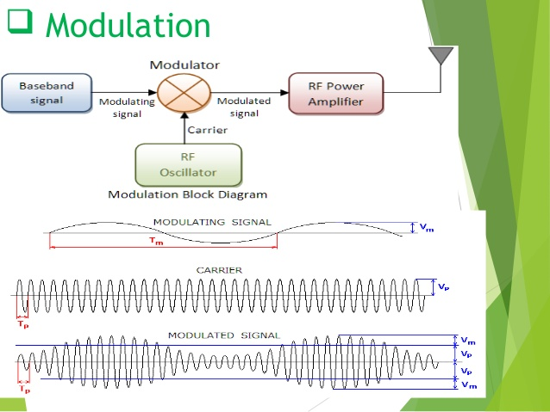
What is modulation
Modulation is the process of varying one or more properties of a high frequency periodic waveform, called the carrier signal, with a separate signal called the modulation signal that typically contains information to be transmitted.
For example, the modulating signal might be an audio signal, a video signal etc.

Slide 37
Why do we need modulation
The modulation is necessary for the following reasons:
Reduction in the height of the antenna
Avoids mixing of signals
Increases the range of communication
Multiplexing is possible
Improve quality of reception
Reduction in the height of antenna : For the transmission of radio signals, the antenna height must be a multiple of (λ/4). where λ is the wavelength (λ = c/f).
The minimum antenna height required to transmit a base-band signal of f = 10KHz is calculated as follows:
Minimum antenna height = λ/4=C/4f=3×10⁸ /(4×10×10³)= 7500 m i.e. 7.5 km
The antenna of this height is practically impossible to install.
Now consider a modulated signal at f = 1MHz
The minimum height is given by=λ/4 =c/4f
=3×10⁸ /(4×10×10⁶)
= 75 m
This size antenna can be installed practically.

Slide 38
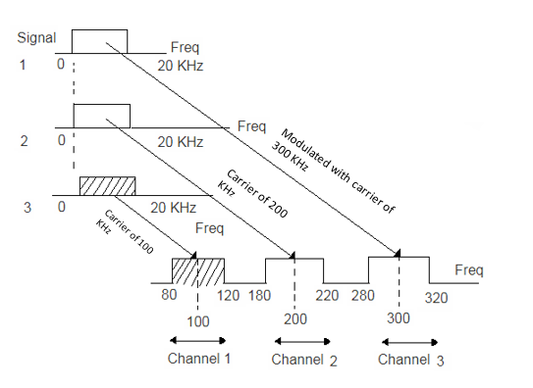
Avoid mixing of signals

Slide 39
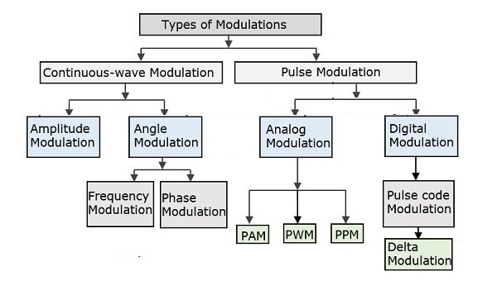
Different types of modulation systems

Slide 40
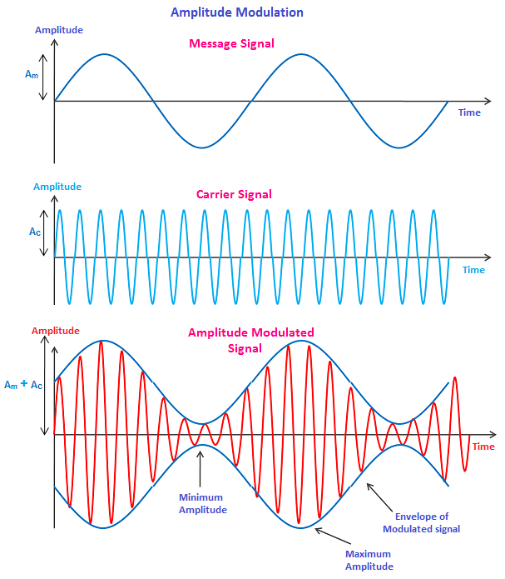
Amplitude modulation (AM)
The carrier is a sine wave frequency
The carrier frequency is much higher than the frequency of modulating signal.
Here, the information is contained in its amplitude variation.
The frequency of the carrier remains constant.
AM is used in radio and TV broadcasting applications.

Slide 41
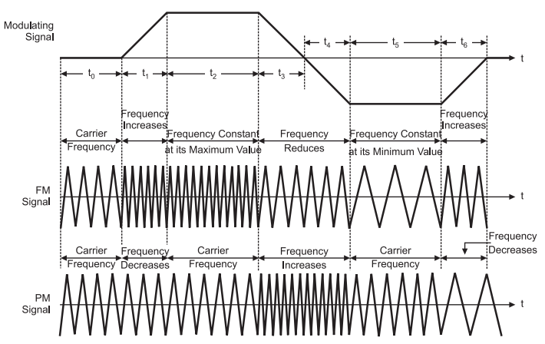
Frequency modulation (FM)
The frequency of the carrier is changed in proportion with the amplitude of the modulating signal.
The amplitude of the carrier remains constant.
FM is used for TV, sound, FM radio and police wireless transmission.

Slide 42
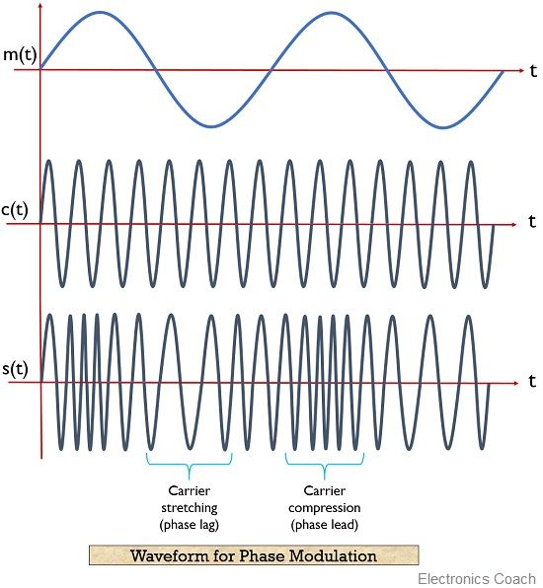
Phase modulation (PM)
The phase shift of the carrier is changed in proportion with the amplitude of the modulating signal.
The amplitude of the carrier remains constant.
PM is used for generation of FM.
FM signal produced from PM signal is very stable.
The centre frequency called resting frequency is extremely stable.

Slide 43
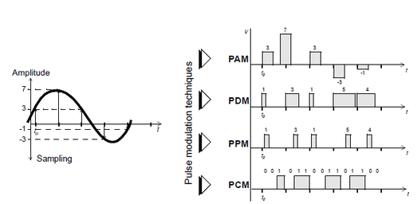
Pulse analog modulation
The carrier is in the form of pulses instead of being a sinewave.
In PAM, the amplitude of the carrier is varied.
In PWM, the width of the carrier is varied.
In PPM, position of the pulses is varied with the amplitude of modulating signal.

Slide 44
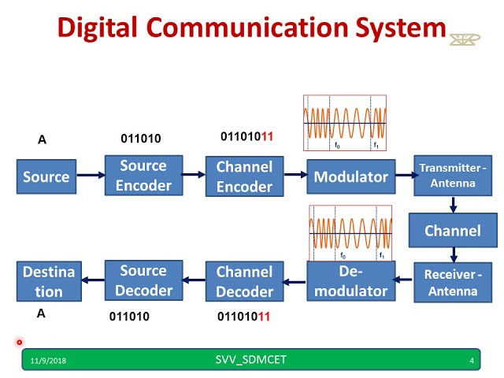

Slide 45
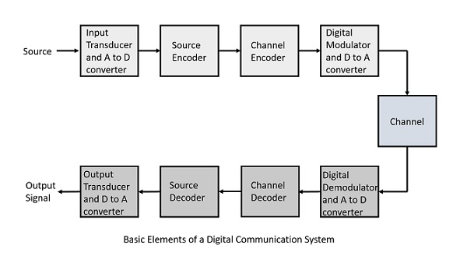
Digital Communication System
A/D Converter: Analog to Digital Converter
D/A Converter: Digital to Analog Converter

Slide 46
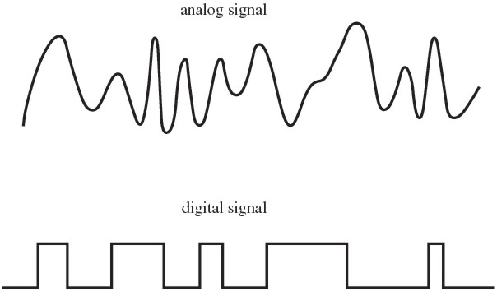

Slide 47
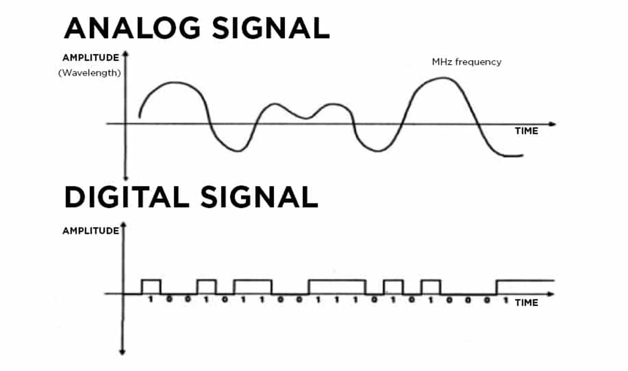

Slide 48
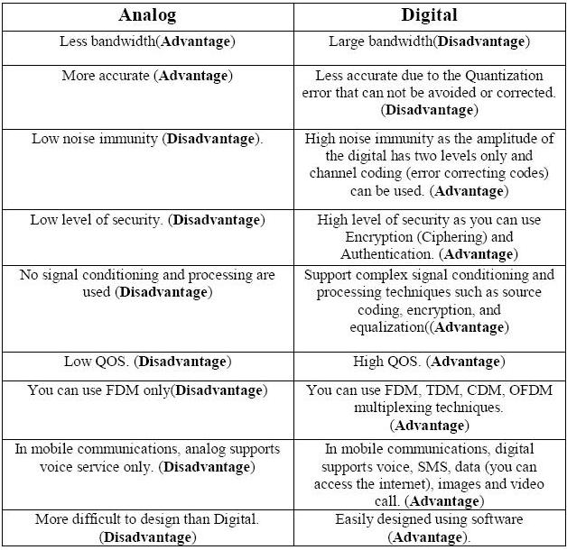
Comparison of Analog and Digital Modulation

Slide 49
Limitation of communication systems
Physical limitations:
Bandwidth limitations
Measure of speed
The system ability to follow signal variations depends on the transmission bandwidth
Available bandwidth determines the maximum signal speed.
Noise limitations
Unavoidable
The kinetic theory
Noise relative to information signal is measured in terms of signal to noise ratio (SNR)
Compromise within:
Transmission time and power
SNR performance
Cost of equipments
Channel capacity
bandwidth

